Slide 1
Evaluation: Inspection, Analytics and Model
Sara Muneeb
sara.muneeb@cuilahore.edu.pk
Computer Science Department

Slide 2
Introduction
Methods that are based on understanding users
Knowledge codified in heuristics
Heuristic Evaluation and Walkthroughs
Data collected remotely
Analytics and A/B testing
Models that predict users’ performance
Predictive modeling (Fitt’s Law)

Slide 3
Inspection
Done by experts or researchers who are knowledgeable about both interaction design and the needs and typical behavior
of users.
Heuristic Evaluation
Cognitive Walkthrough

Slide 4
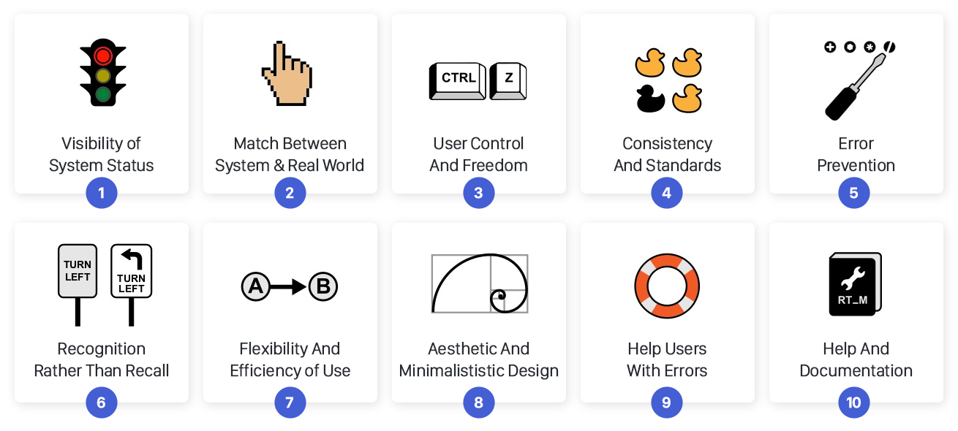
Heuristic Evaluation

Slide 5
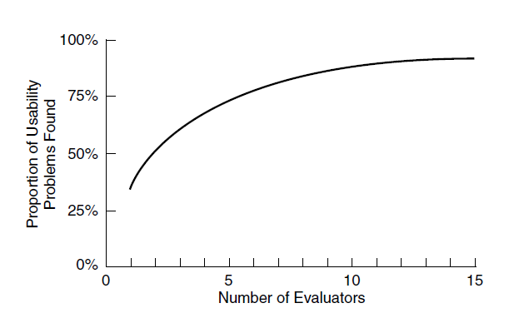
Heuristic Evaluation
Empirical tests were conducted suggesting that 3–5 can typically identify up to 75 percent of the total usability problems.

Slide 6
Heuristic Evaluation – Web Design
Clarity
Minimize Unnecessary Complexity and Cognitive Load
Provide Users with Context
Promote a Pleasurable and Positive User Experience
(Budd, 2007)

Slide 7
Heuristic Evaluation – Stages
A briefing session, in which the user researchers are briefed about the goal of the evaluation.
The evaluation period, in which the user researchers typically spend 1–2 hours independently inspecting the product
The debriefing session, in which the researchers discuss their findings with designers to prioritize the problems and give suggestions for solutions.

Slide 8
Cognitive Walkthrough
Cognitive walk-throughs involve simulating how users go about problem-solving at each step in a human-computer interaction
Will the correct action be sufficiently evident to the user?
Will the user notice that the correct action is available?
Will the user associate and interpret the response from the action correctly?

Slide 9
Cognitive Walkthrough - Stages
Characteristics of typical users are identified , sample tasks are developed , a description, mock-up, or prototype of the interface is developed
2,3 designer and or UX researchers walk through the action sequences for each task, placing it within the context of a typical scenario along with answering the previous questions.
As the walk-through is being done, a record of critical information is compiled.
The design is then revised to fix the problems presented.

Slide 10
Analytics and A/B Testing
A variety of users’ actions can be recorded by software automatically, including
key presses
mouse or other pointing device movements
time spent searching a web page
looking at help systems
and task flow through software modules.

Slide 11
Web Analytics
Web analytics is a form of interaction logging that was specifically created to analyze users’ activity on websites so that designers could modify their designs to attract and retain customers.
Examples : Google Analytics, Moz Analytics, TruSocialMetrics, Clicky, KISSmertics, CrazyEgg, ClickTale

Slide 12
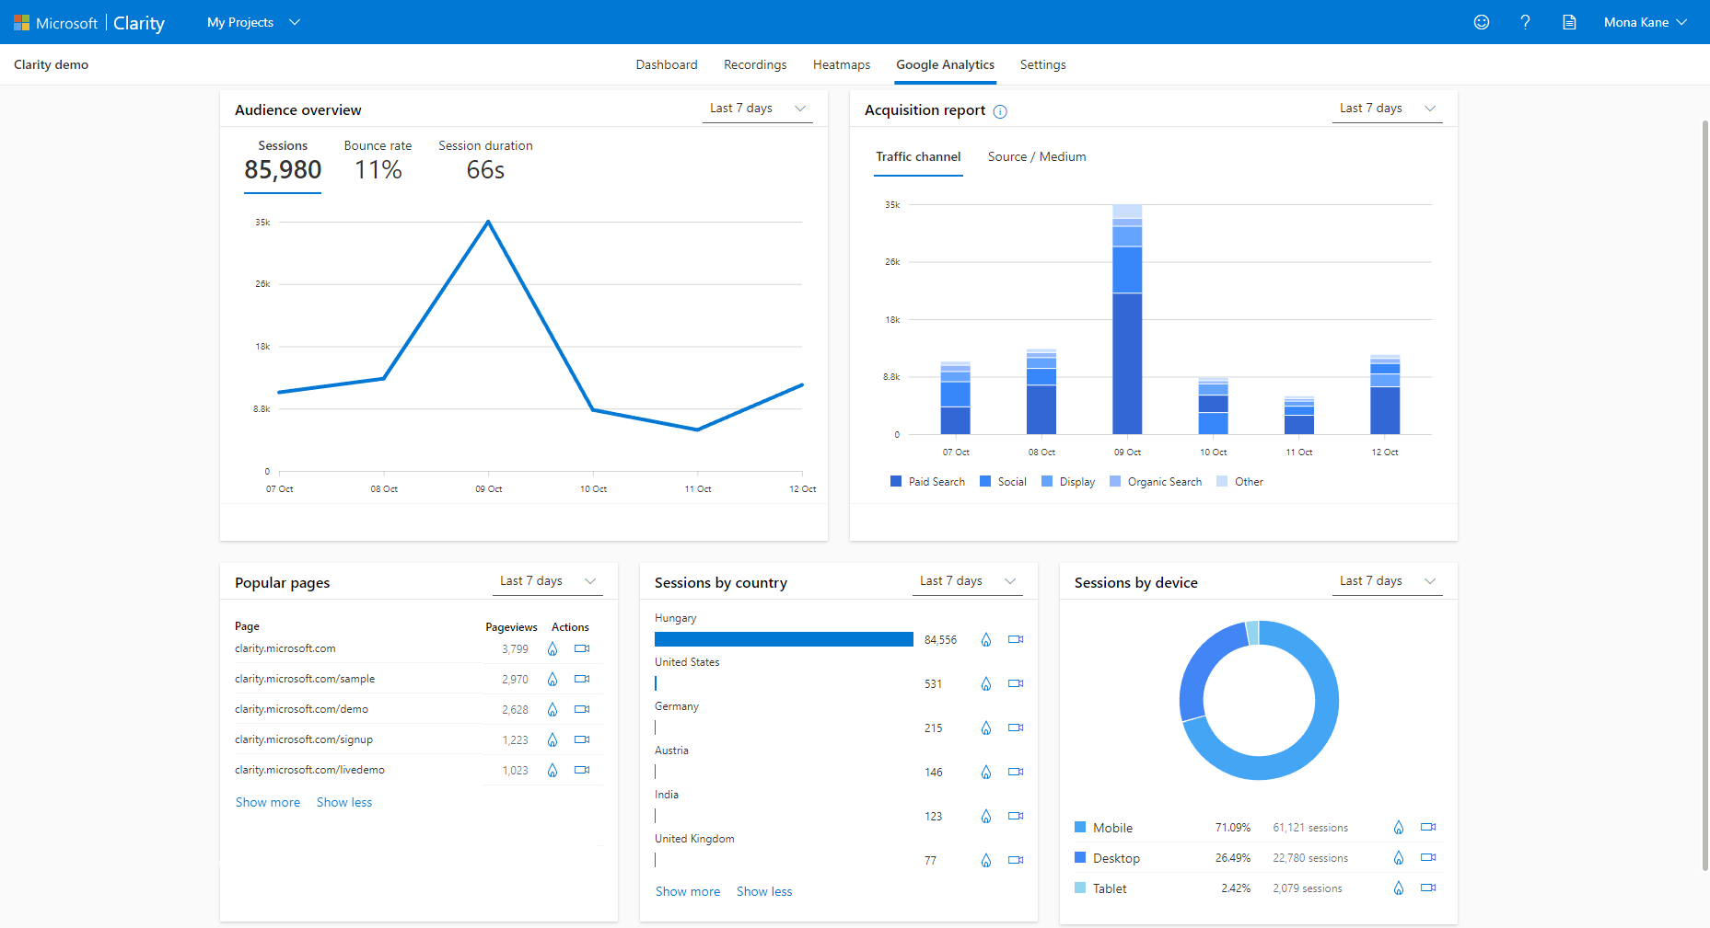
Web Analytics – Google

Slide 13
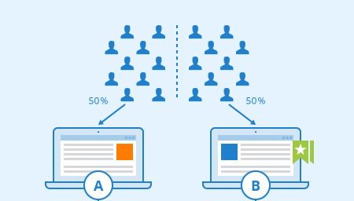
A/B Testing
A/B testing is a large-scale experiment to evaluate how two groups of users perform using two different designs - one of which acts as the control and the other as the experimental condition, that is, the new design being tested.

Slide 14
A/B Testing
Controlled experiment that often involves hundreds or thousands of participants.
A/B testing involves a “between subjects design”
To do A/B testing, a variable of interest is identified.

Slide 15
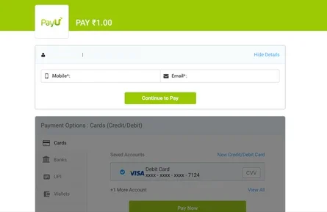
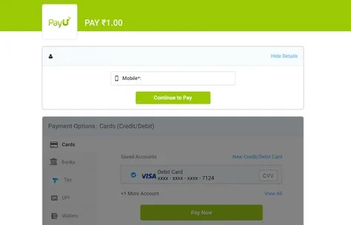
A/B Testing – PayU Example
Controlled
Variable
Company was able to register an improvement of 5.8% in conversions as compared to the control.

Slide 16
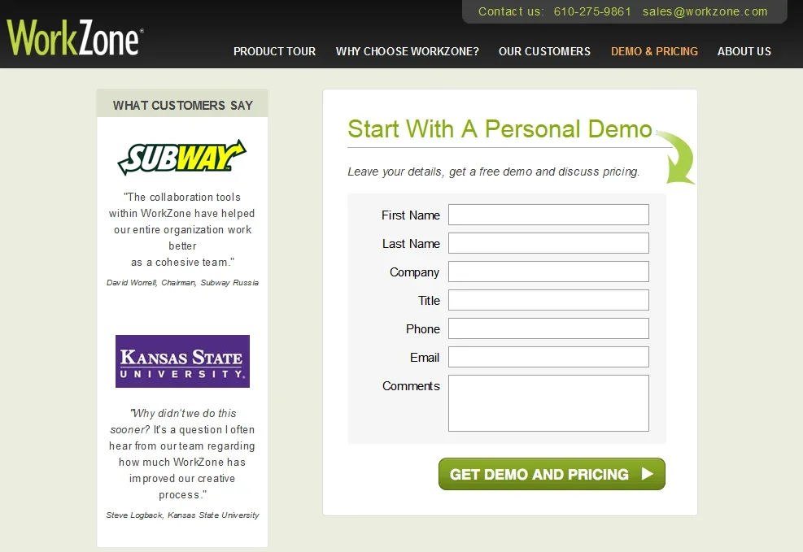
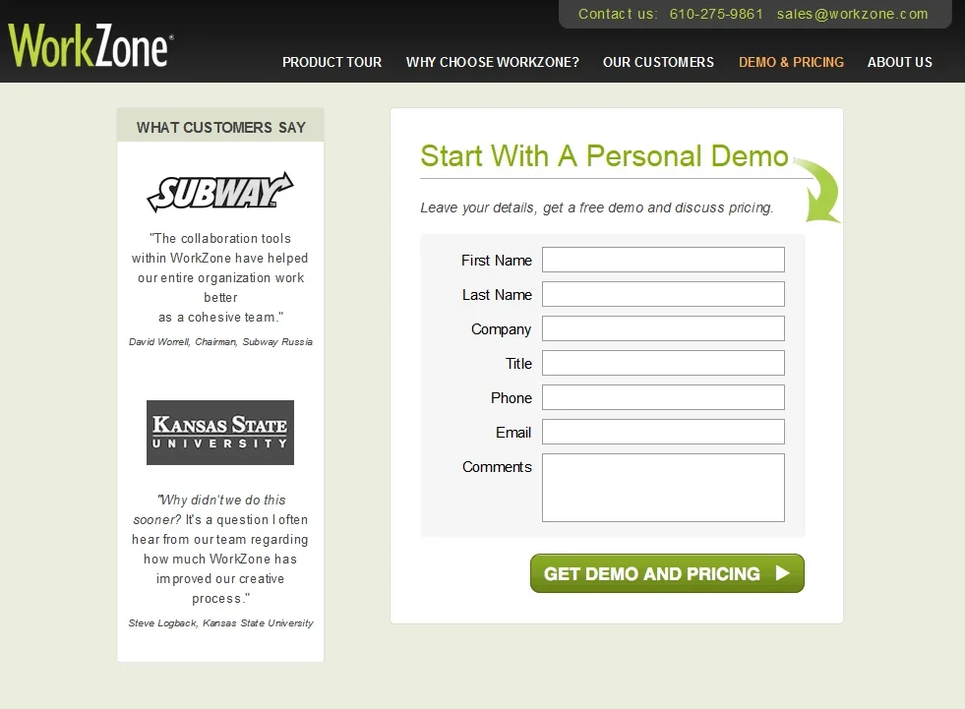
A/B Testing – WorkZone Example
Controlled
Variable
It projected a 34% increase in form submissions and marked a 99% statistical significance.

Slide 17
Predictive Model
Predictive models use formulas to derive various measures of user performance.
Predictive modeling provides estimates of the efficiency of different systems for various kinds of tasks.
Example: Fitt’s Law , Action Analysis

Slide 18
Fitt’s Law
Fitt’s law (Fitts, 1954) predicts the time it takes to reach a target using a pointing device.
In interaction design, it has been used to model the time it takes to point at a target based on the size of the object and the distance to the object.
It helps designers decide
where to locate physical or digital buttons,
what size to make them
and how close together to put them on a touch display or a physical device

Slide 19
Fitt’s Law
Fitts’ law states that:
T = klog2 ( D/S +1.0)
Where:
T = time to move the pointer to a target
D = distance between the pointer and the target
S = size of the target
And k is a constant of approximately 200 ms/bit.

Slide 20
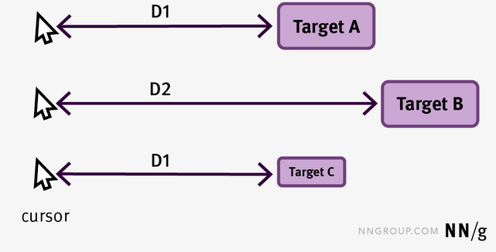
Fitt’s Law - Example

Slide 21
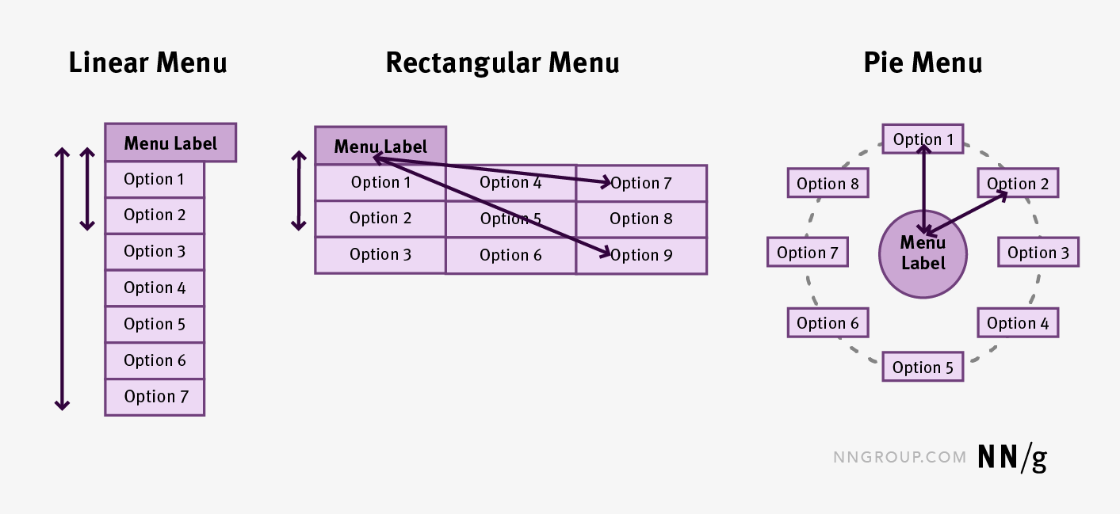
Fitt’s Law - Example

Slide 22
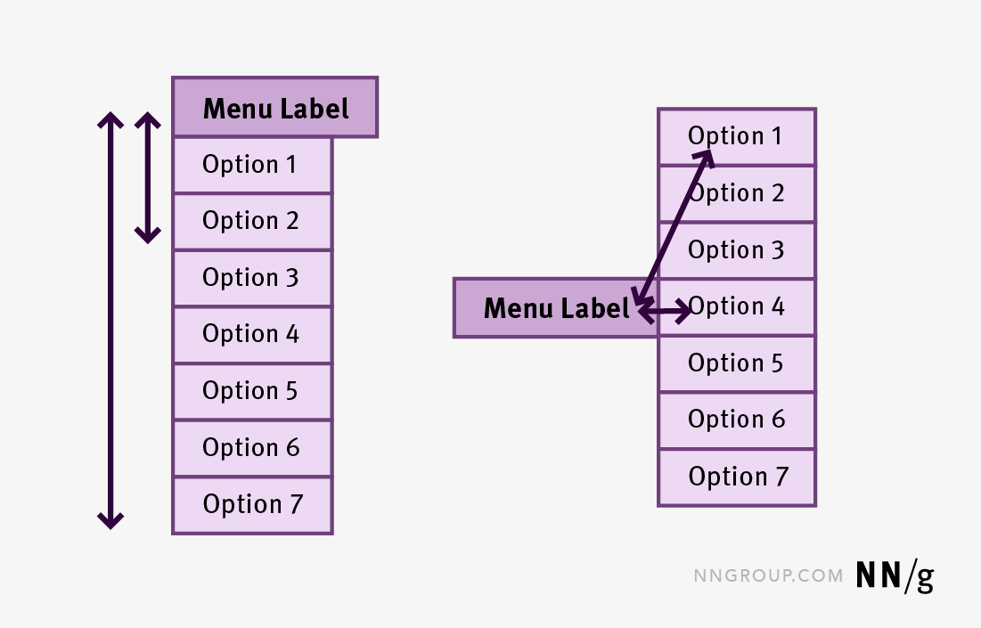
Fitt’s Law - Example

Slide 23
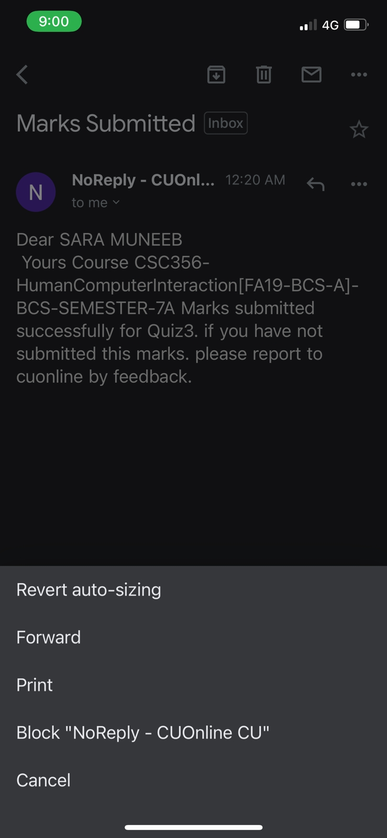
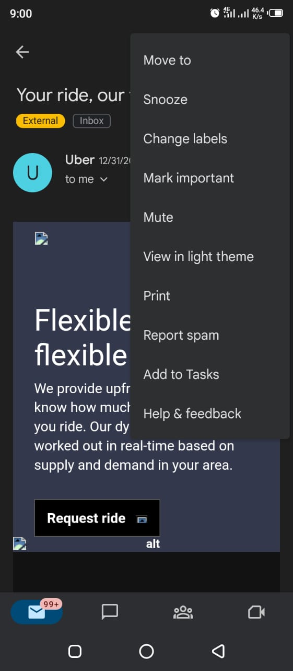
Fitt’s Law - Example
iPhone
Android

Slide 24
Action Analysis
Quantitative analysis of actions to predict the time a skilled user requires to complete tasks (efficiency).
Focus is on what the users actually do rather than on what they say they do.
Two flavors of Action Analysis (levels of detail):
Formal or “Keystroke-Level”
Informal or “Back-of-the-Envelope”

Slide 25
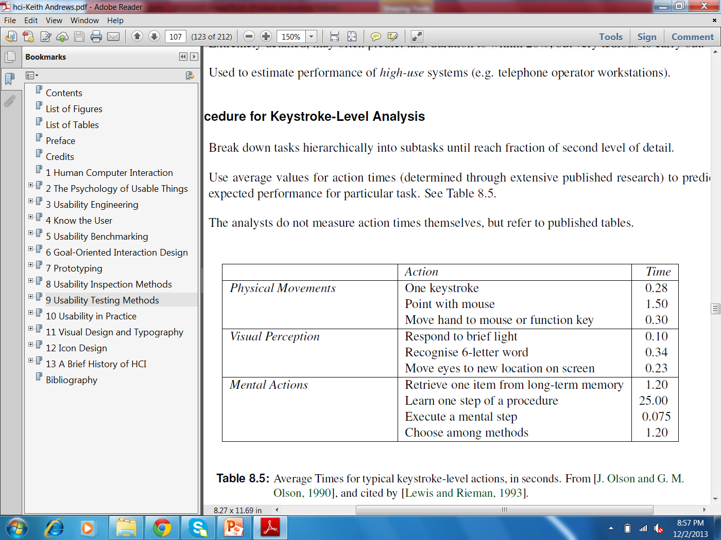
Keystroke-Level Analysis - Stages
Break down tasks hierarchically into subtasks until reach very detailed level, for example key press.
Use average values for action times (determined through extensive published research) to predict expected performance for particular task.

Slide 26
GOMS Model
Developed from GOMS (Goals, Operators, Methods, Selection) modeling
Extremely detailed, may often predict task duration with up to 20% of margin of error even before the interface is prototyped, but very tedious to carry out
The time taken to perform a task is the sum of the time it takes to perform the elementary gestures that make up that task.

Slide 27
GOMS Model - Stages
The steps
Define the task
Break it down into its gestures
Apply mental operators
Add up the numbers

Slide 28
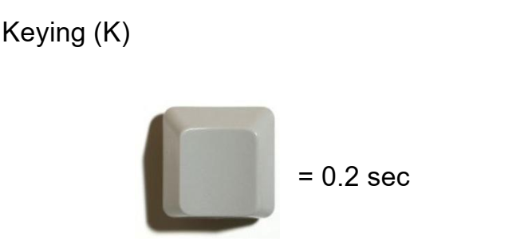
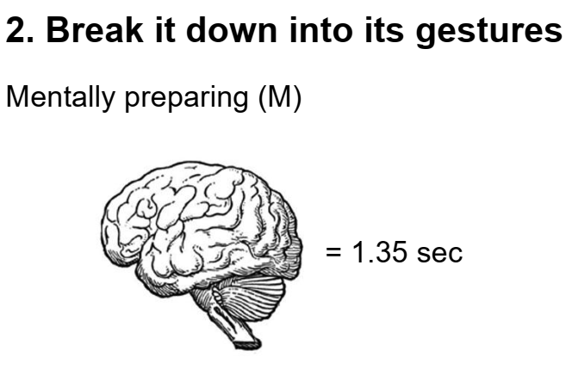
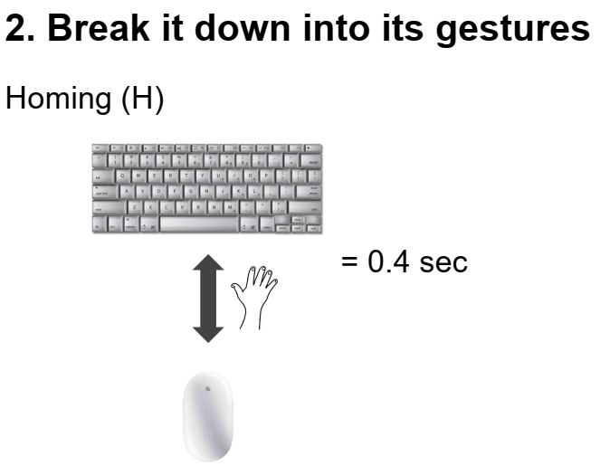
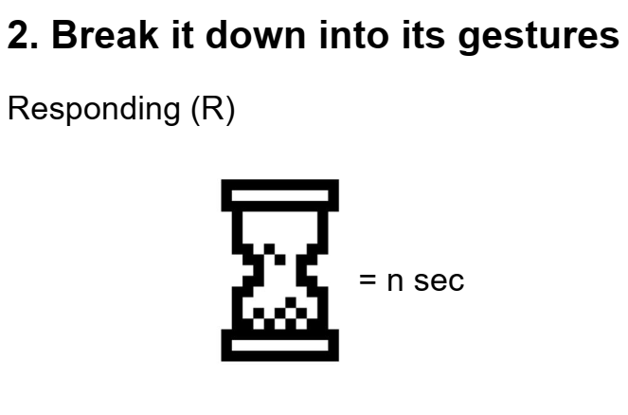
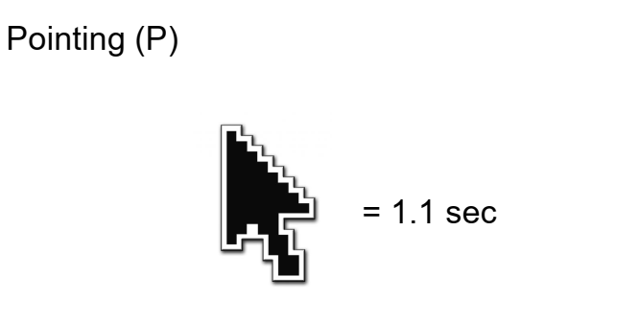
GOMS

Slide 29
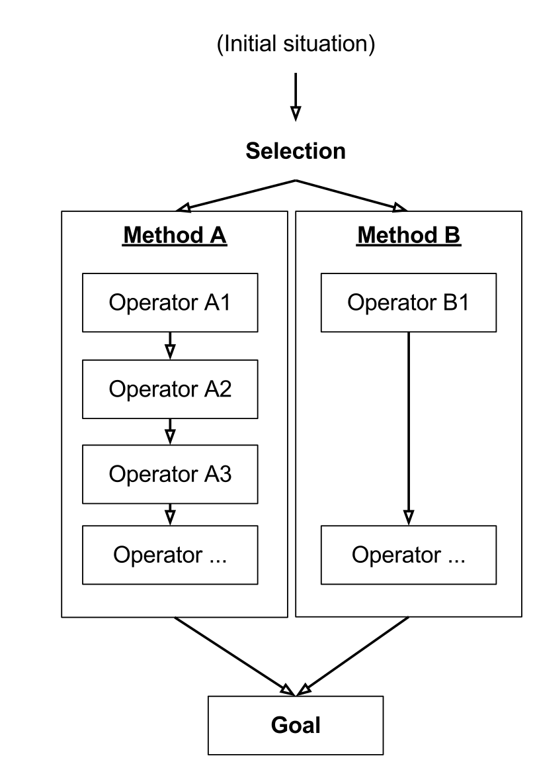
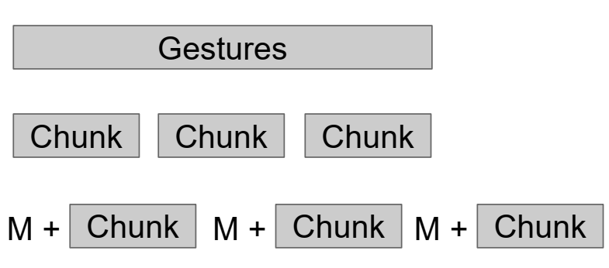
GOMS Model

Slide 30
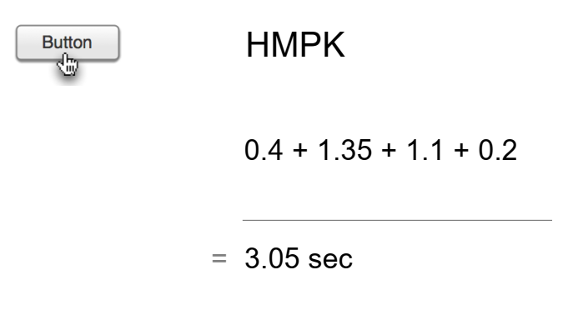
GOMS Model

Slide 31
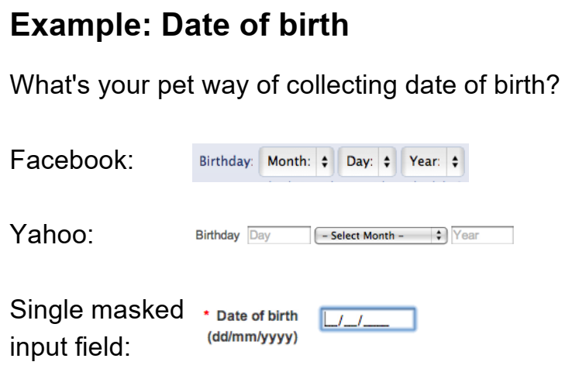
GOMS Model - Example

Slide 32
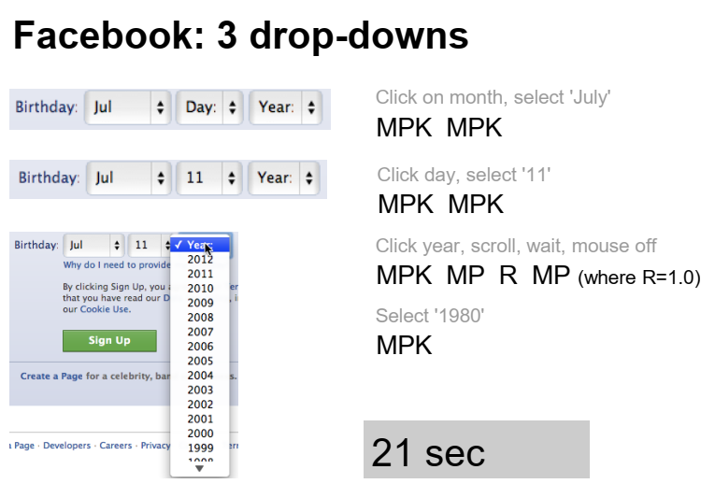
GOMS Model - Example

Slide 33
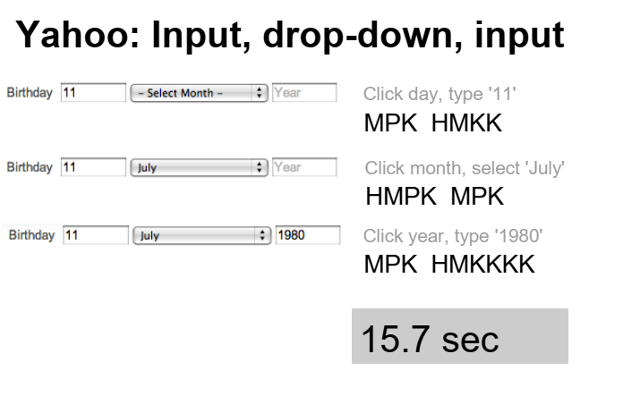
GOMS Model - Example

Slide 34
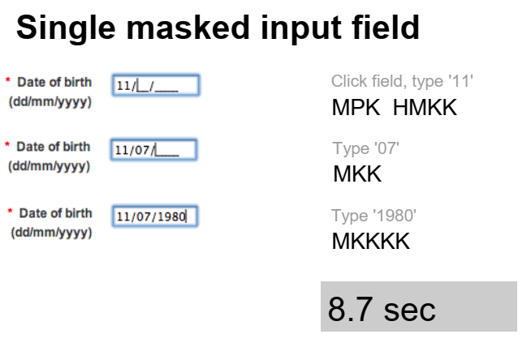
GOMS Model - Example

Slide 35
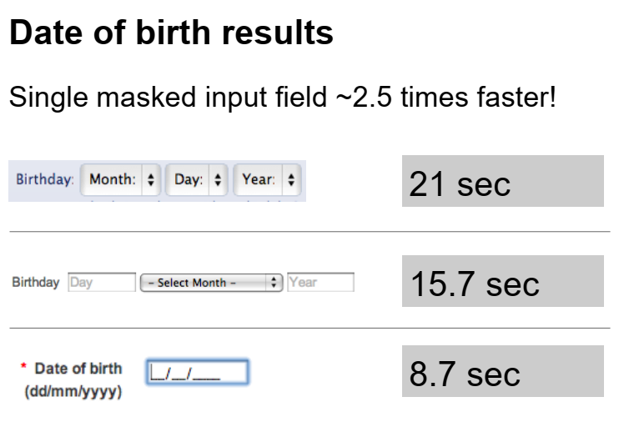
GOMS Model - Example

Slide 36
Back-of-the-Envelope
List actions required to complete a task (as before), but in much less detail – at level of explaining to a user , for example
Select Save from the File menu
Edit the file name
Confirm by pressing OK
At this level of analysis, every action takes at least 2 to 3 seconds
Allows quick estimation of expected performance of interface for particular task.

Slide 37
Conclusion
Inspection Methods
Analytics and A/B Testing
Predictive Models

